Slide 1
I210 Information Infrastructure
Lab 5

Slide 2
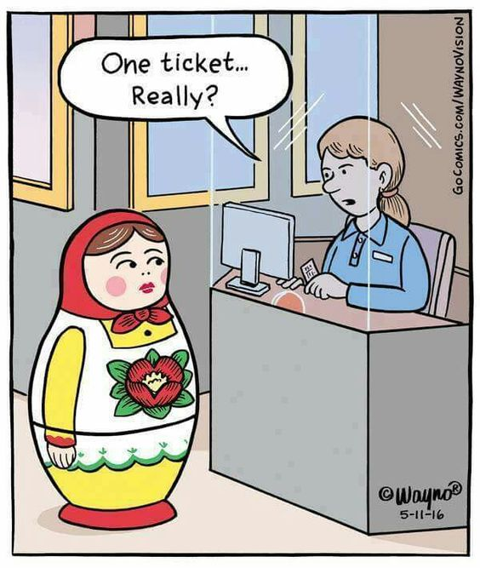
Today
Nested sequences!

Slide 3
Quick Review – Nested Sequences
Items in Lists and Tuples can also be other Lists and Tuples:
nested_list = [ ("Python","PHP"), "Hello", [2.3, 4] ]
nested_tuple = ( ("Python","PHP"), "Hello", [2.3, 4] )
Ok, so we can truly mix and match what items are in our lists or tuples.

Slide 4
Quick Review – Nested Sequences
scores = [ ("Max", 200), ("Ava", 180), ("Seth", 215) ]
If the nesting happens in a pattern like this, we can think of our nested list as a table:
 | Name | Score
Row 0 | “Max” | 200
Row 1 | “Ava” | 180
Row 2 | “Seth” | 215

Slide 5
When to Use Nested Sequences?
ASK:
Do I need to store multiple pieces of data?
Does each piece of data need multiple parts?
Would a table make sense to represent my data?
AIs / UIs share your opinions on this:
When is a good time to use a nested sequence?

Slide 6
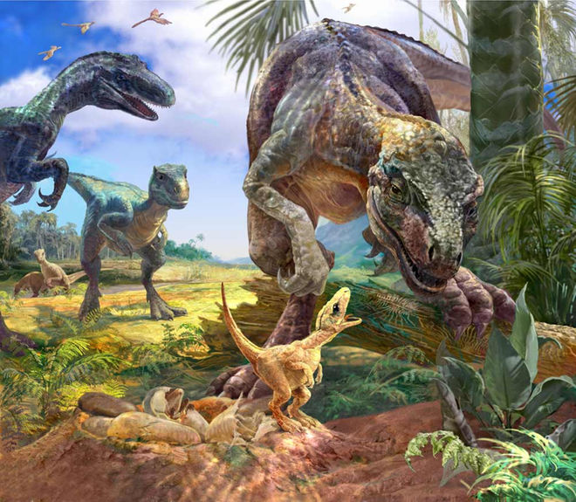
DINOSAURS
As part of IU Geology, you take a trip to Montana. Your group discovers fossilized dinosaur nests! Can you help your team better organize and display their data?

Slide 7
Nest the Sequence (Group Work)
With your group, put the following basic dinosaur data into a nested sequence:
Dinosaurs | Name | Weight in Lbs | Description | Period
Row 0 | Tyrannosaurus | 16000 | carnivore | Late Cretaceous
Row 1 | Ankylosaurus | 10000 | herbivore | Late Cretaceous
Row 2 | Stegosaurus | 6000 | herbivore | Late Jurassic
Row 3 | Deinonychus | 175 | carnivore | Early Cretaceous

Slide 8
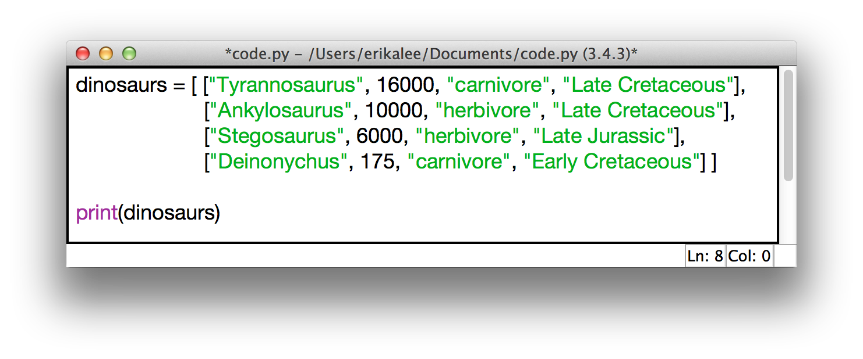
Nest the Sequence (Solution)

Slide 9
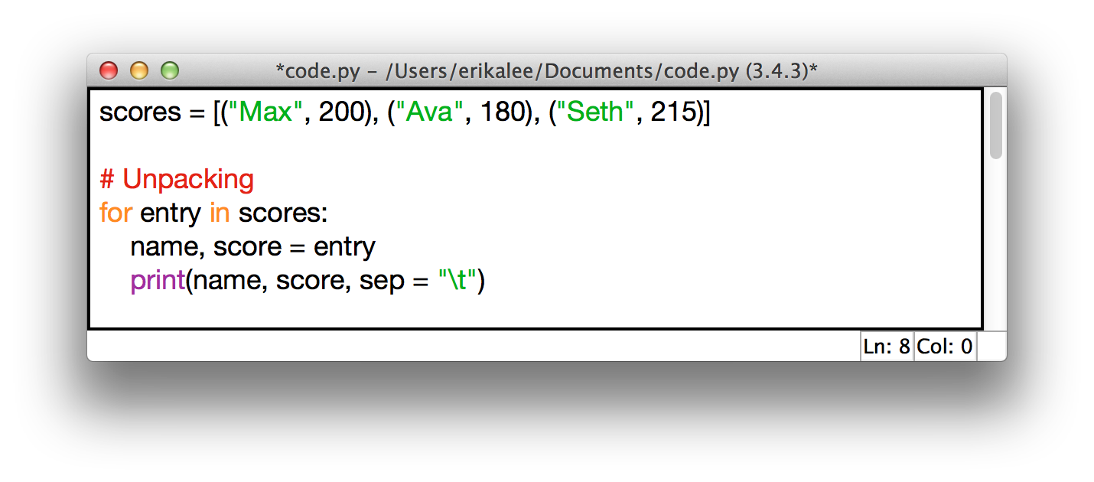
Quick Review – Nested Sequences
If we know exactly how many pieces are in the inner sequence, we can do what’s called unpacking.
This assigns the pieces of the inner sequence to multiple variables at once! This can be better when using entry[0] or entry[1] is confusing.
Output:
>>>
Max 200
Ava 180
Seth 215
>>>

Slide 10
Review - Formatting Output
Let’s say we want to print out a date as Month Day, Year:
month = "May"
day = 23
year = 2016
output = "{0} {1}, {2}"
print(output.format(month, day, year))
>> May 23, 2016
Notice that .format also converts the ints to strings.
0, 1, 2, etc… represent index positions -- which variable passed to .format() should be displayed.

Slide 11
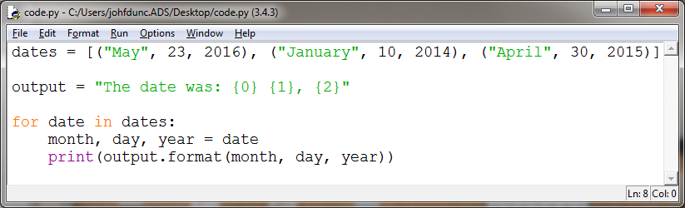
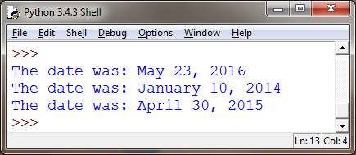
Review - Formatting Output
If we need to print out several dates, it's now very easy to do so by changing the variables we pass to .format()

Slide 12
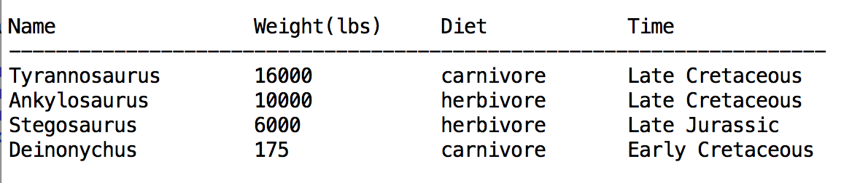
Unpack the Sequence (Group Work)
Use unpacking and the .format() method to print the data about each dinosaur in a nicely spaced table.
Note: you might have to convert the weight to a string to get it to play nice when printing.

Slide 13
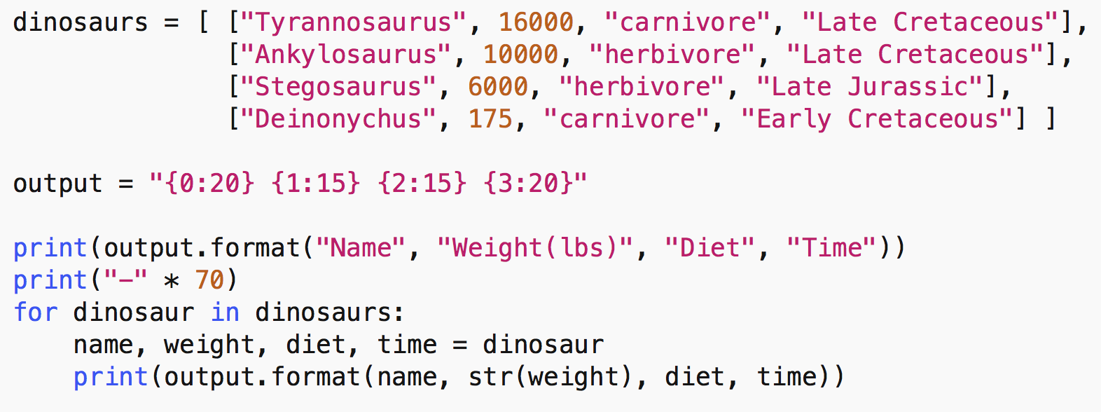
Unpack the Sequence (Solution)

Slide 14
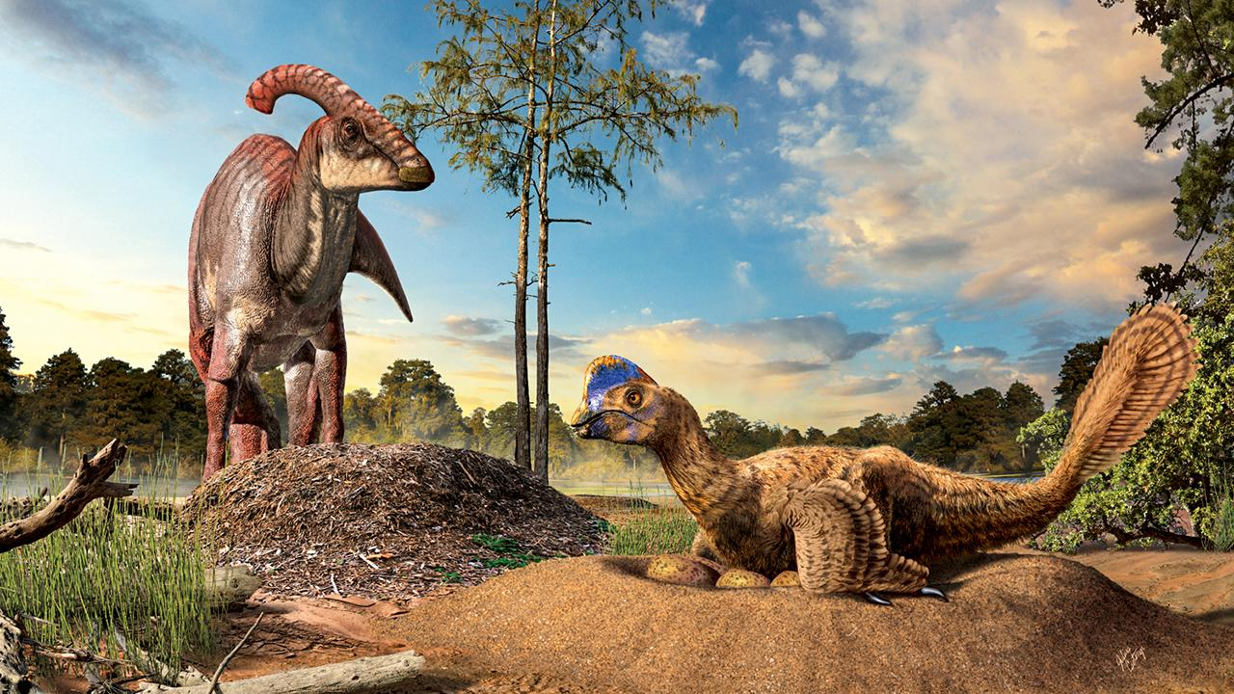
Great work! Now that you’ve helped organize the data, create a way for your team to keep track of each dinosaur’s nest and the number of fossilized eggs found.

Slide 15
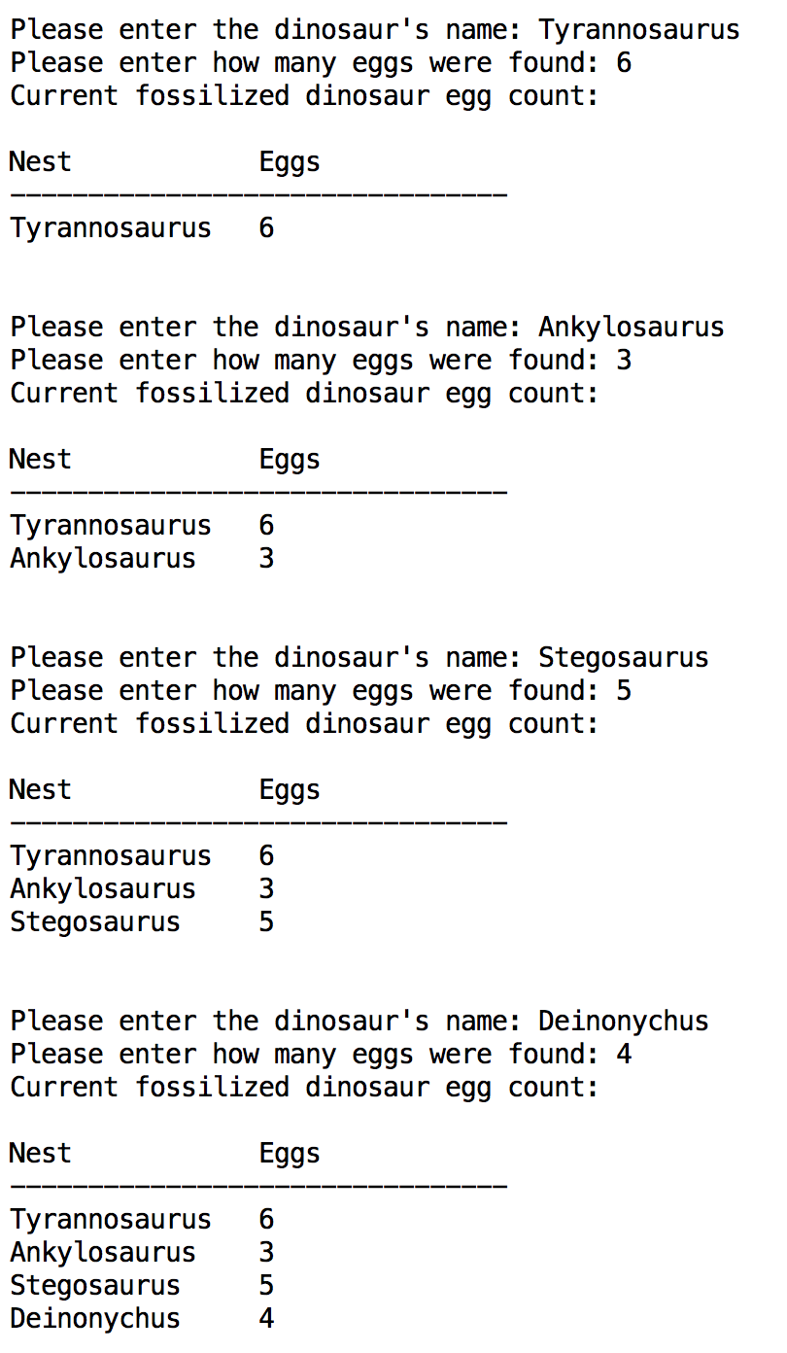
Table Print 4
Use table_print v3 to complete this problem. The code in this function doesn’t change!!
Enter each dinosaur’s name (which nest found) and how many eggs, individually. Display all names and number of eggs found after each entry.
We’ll use the 3rd argument (padding) to table_print to automatically re-size the table as larger values are entered!
Remember: ‘\n’ = new line

Slide 16
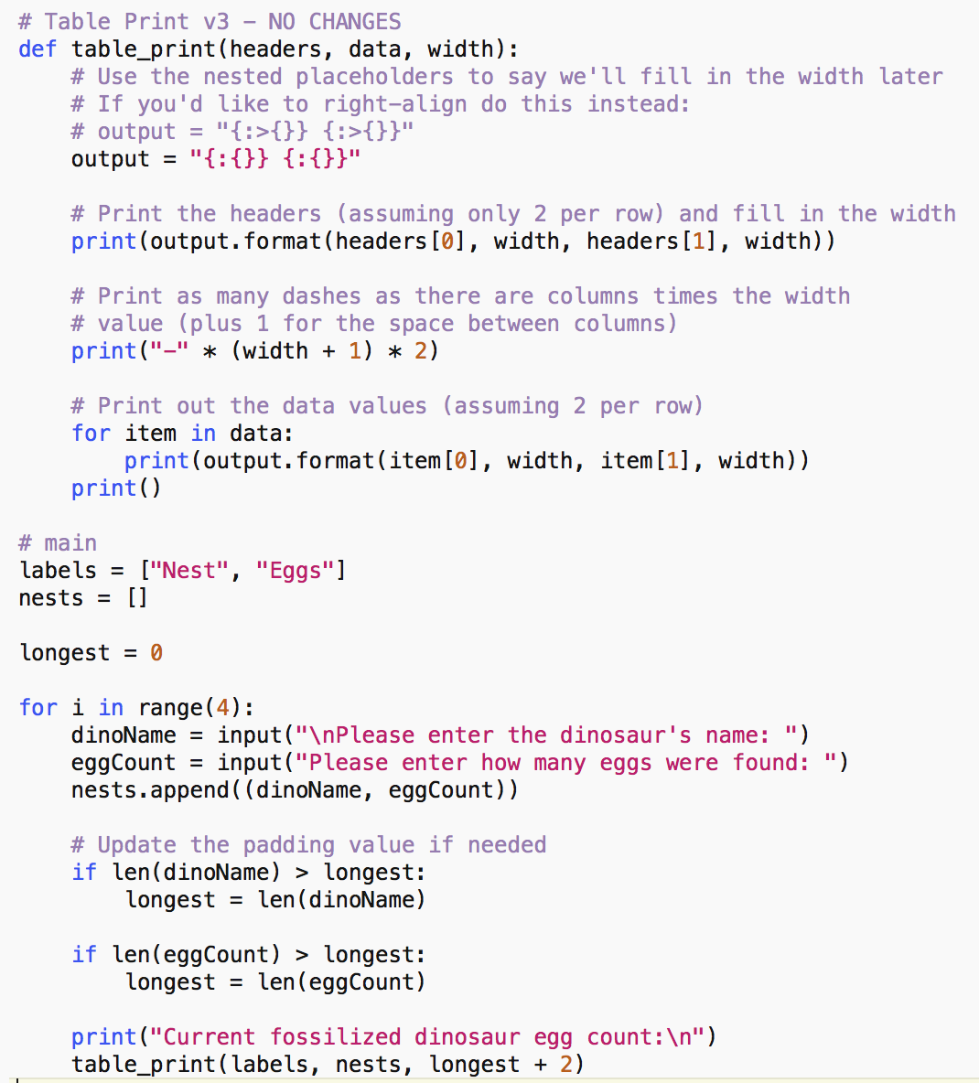
Table Print 4 (Solution)

Slide 17
Questions?

